Slide 1
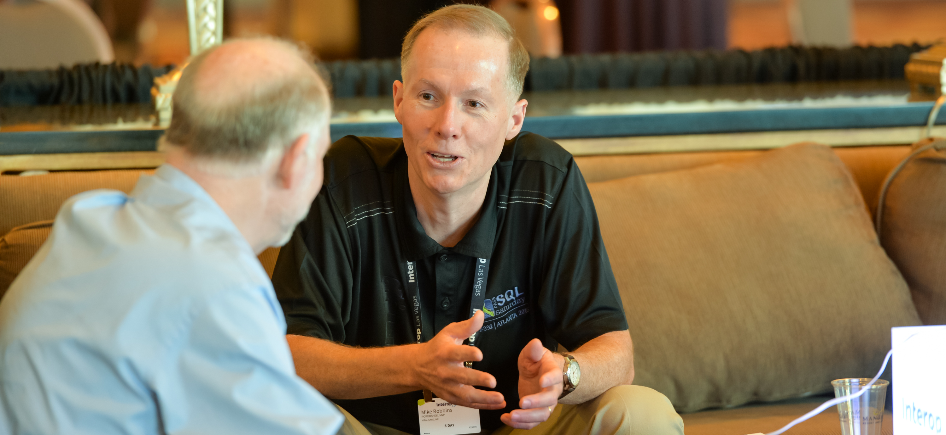


Closing
remarks
OnRamp Team

Slide 2
Key takeaways for success
Your job is not your career
Activity is not equal to productivity
Focus on impact, not activity
Individual accomplishments
Contribute to the success of others
Results that build on the work, ideas, and efforts of others

Slide 3
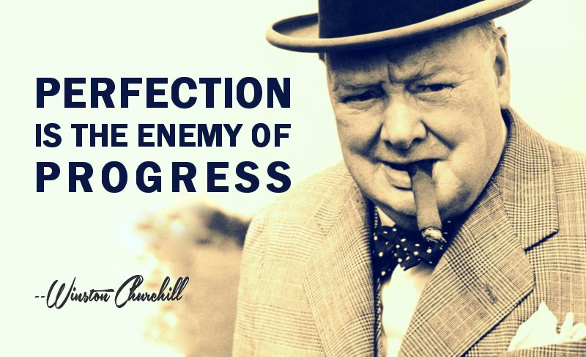
Perfection is the enemy of progress

Slide 4

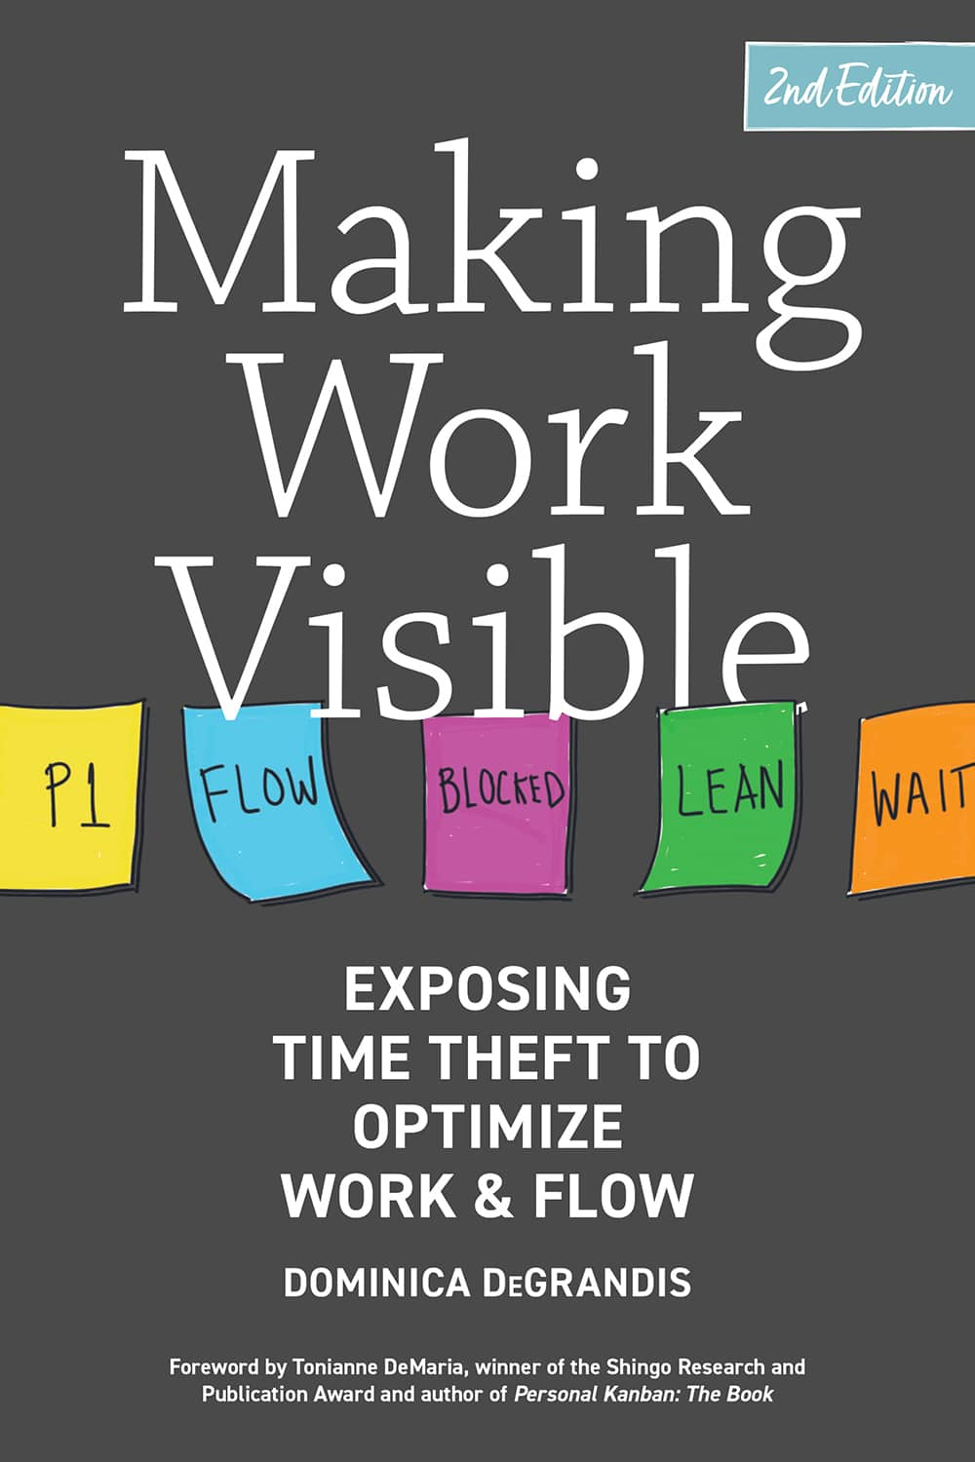
Recommended books

Slide 5
Select-Object –Property Resources
The PowerShell Best Practices and Style Guide
https://poshcode.gitbook.io/powershell-practice-and-style
https://github.com/PoshCode/PowerShellPracticeAndStyle
The Official Product Documentation for PowerShell
https://learn.microsoft.com/powershell/
PowerShell.org
https://powershell.org/
PowerShell Podcast
https://powershellpodcast.podbean.com/

Slide 6

Complete the Survey
https://survey.sogolytics.com/r/wkp86t

Slide 7
Get-Contact –Identity Presenter
Blog: mikefrobbins.com
Bluesky: @mikefrobbins.com
LinkedIn: www.linkedin.com/in/mikefrobbins
GitHub: github.com/mikefrobbins

Slide 8


